Slide 1


FINE-TUNING LARGE LANGUAGE MODEL (LLM) TO ANSWER BASIC QUESTIONS FOR PROSPECTIVE NEW STUDENTS AT SYIAH KUALA UNIVERSITY USING THE RETRIEVAL-AUGMENTED GENERATION (RAG) METHOD
Hary Rachmat
Prof. Dr. Ir. Hammam Riza M.Sc. IPU
Prof. Dr. Taufik Fuadi Abidin, S.Si., M.Tech
Department of Informatics Universitas Syiah Kuala Aceh, Indonesia haryrachmat10@gmail.com
Research Center for Artificial Intelligence and Cyber Security National Research and Innovation Agency (BRIN) Jakarta, Indonesia hammam.riza@brin.go.id
Department of Informatics Universitas Syiah Kuala Aceh, Indonesia taufik.abidin@usk.ac.id
Notes:
Assalamualaikum Wr. Wb.
The honourable All of the Committee and audience who has come in this event. First of all, let us praise the presence of Allah, who has given His grace and guidance to us. Because of His grace we can gather on this day in the event. And also let us deliver sholawat and salam to our prophet Muhammad SAW who has brought us from the darkness to the brightness. My name is Hary Rachmat In this presentation, I will talk to you about my paper.
As you can see on the screen, The topic of my paper is

Slide 2

DISCUSSION
01
INTRODUCTION
02
RELATED RESEARCH
03
LITERATURE REVIEW
04
RESEARCH METHODS
Conference | 24-25 October 2024
Discussing the background of the research.
Discussing research that has been done by researchers before.
Discussing the theoretical foundations related to research.
Discussing the research schedule and the steps to be taken.
Notes:
Here are some things that will be discussed in this presentation.
First will be discussed
Next we will discuss about

Slide 3
DISCUSSION
05
RESULTS AND DISCUSSION
06
CONCLUSIONS AND SUGGESTIONS
Conference | 24-25 October 2024
Discuss the results of the research.
Research conclusions and suggestions.

Slide 4

01
INTRODUCTION
Conference | 24-25 October 2024

Slide 5
Introduction (1/4)
Conference | 24-25 October 2024
So far, information related to academics at University of Syiah Kuala (USK), in addition to being informed in the form of a website, is also summarized in the form of Frequently Asked Questions (FAQ). The information in the form of websites and FAQs is not interactive so certain information should be searched in the web news or FAQ list. Therefore, an alternative way of delivering information that is more interactive using chatbots is needed. Chatbots can be built using Large Language Models (LLMs) such as Mistral 7B. Mistral 7B is a large language model that can be applied to answer questions such as academic information using data collected from universities.

Slide 6
Introduction (2/4)
Conference | 24-25 October 2024
Problem Formulation
Questions and answers related to academics have been compiled in the form of FAQ. These FAQs are not interactive so answers or information should be searched in the list of FAQs. Therefore, an alternative way of delivering interactive information using chatbots is needed. The performance of fine-tuning and RAG methods in the development of chatbots for academic information at USK is not yet known. External documents in the form of statements are not yet available in the form of statements necessary to use RAG in the development of LLMs in the academic field.

Slide 7
Introduction (3/4)
Conference | 24-25 October 2024
Research Objectives
Develop LLMs that can provide academic information at USK. Get the best-performing method in chatbot development. Collect external documents in the form of academic information at USK which will be used in the RAG method in the development of LLM in the academic field.

Slide 8
Introduction (4/4)
Conference | 24-25 October 2024
Research Benefits
Academic information at USK that can be accessed interactively by utilizing LLM. The best method in the application of LLM in the academic field was obtained. External documents are available that can be used in the development of LLMs using the RAG method. Improvement of services and satisfaction provided to students at USK. It is an initial study with the use of LLM and obtaining new knowledge and information related to domain variations in the application of LLM in the field of academic administration at USK.

Slide 9
02
RELATED RESEARCH
Conference | 24-25 October 2024

Slide 10
Related Research 1/3
Conference | 24-25 October 2024
One of the commonly used and popular chatbot applications today is ChatGPT, which was developed by OpenAI and released at the end of 2022 (Mohamadi et al., 2023). Various studies seek to explore the capabilities of ChatGPT such as those conducted by Baker et al. (2024) in the medical field developed to aid clinical documentation. (Loukas et al., 2023). classify texts in the field of banking. (Trozze et al., 2023). in the field of law to determine which laws have the potential to be violated.
Notes:
Aid = membantu
to aid clinical documentation = membantu dokumentasi klinis
Violated = dilanggar

Slide 11
Related Research 2/3
Conference | 24-25 October 2024
In addition to closed-source LLMs such as GPT-4, some studies have used open-source LLMs such as those conducted by (Huang et al.) (2023) by adapting Llama's LLM to the legal domain to assist lawyers in making technical reports. (Bhatti A., et al., 2023). fine-tuning the LLM Llama 70B named "SM70" to address a wide range of complex medical questions as well as clinical decision-making. (Zhao H., et al., 2023). fine-tuning the LLM Llama 7B named "Ophtha-LLaMA2" to help diagnose eye diseases that will provide decision support for doctors.

Slide 12
Related Research 3/3
Conference | 24-25 October 2024
(Barandoni et al. 2024) conducted a comparative analysis of LLMs to extract travel customer needs from TripAdvisor posts by Leveraging a variety of models, including open-source models such as Mistral 7B and closed-source models such as GPT-4 and Gemini. The results highlight the efficacy of open-source LLMs, especially the Mistral 7B, in achieving comparable performance to closed-source models. Research on chatbots as virtual assistants has been conducted by Jonatan & Igor (2023) to improve service efficiency to customers. The research that has been presented has shown the potential of LLM to help work in various fields.
Notes:
Efficacy = Kemanjuran

Slide 13
03
LITERATURE REVIEW
Conference | 24-25 October 2024

Slide 14
Literature Review (1/4)
Conference | 24-25 October 2024
Large Language Models (LLMs) are chatbot models that can help in obtaining information quickly and accurately. The Mistral 7B is one of the chatbot models with 7.3B parameters that is easy to adjust to any task and has outperformed the performance of the Llama 2 13B model in all benchmarks. Fine-tuning means training a model with a specific task using a model that has been trained with datasets on a specific domain. Retrieval augmented generation (RAG) is an approach in creating AI models that can generate text by combining retrieval and generation capabilities.

Slide 15
Literature Review (2/4)
Conference | 24-25 October 2024
Difference between RAG and Fine-tuning
RAG combines text generation with a retrieval mechanism. That is, the model generates text, but retrieves relevant information from a set of documents. RAG are useful for tasks that require models to incorporate specific, current, or domain-specific knowledge from a dataset, such as current news articles or medical research papers.
Notes:
incorporate

Slide 16
Literature Review (3/4)
Conference | 24-25 October 2024
Next...
Fine-tuning is a training technique in which a pre-trained model (such as GPT and Mistral 7B) is further trained on a specific dataset associated with a specific task. This model learns the patterns and task-specific information from the dataset provided during Fine-tuning. Fine-tuning is typically used when it is necessary to apply a trained model to a specific task or domain. This is efficient because the model does not start learning from scratch but refines the existing knowledge for a specific task.
Notes:
https://www.linkedin.com/pulse/differences-between-rag-fine-tuning-xenonstack/

Slide 17
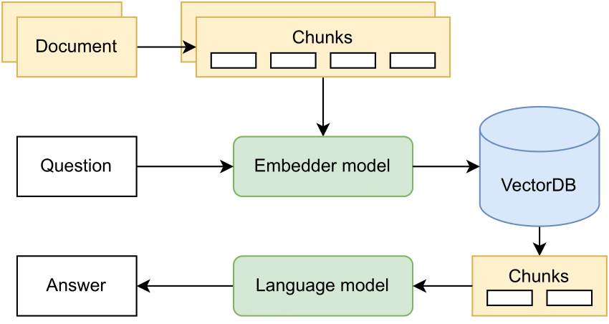
Literature Review (4/4)
Conference | 24-25 October 2024
Figure 1 Architecture on Retrieval augmented generation (RAG). (Source: Rakotoson, Loïc et al., 2024)
Notes:
RAG Architecture
https://www.researchgate.net/figure/Retrieval-Augmented-Generation-Architecture_fig1_378364457
Chunks = Pieces or parts
https://tr-ex.me/terjemahan/bahasa+inggris-bahasa+indonesia/chunks#gref
RAG Chunk Technique
https://www.rungalileo.io/blog/mastering-rag-advanced-chunking-techniques-for-llm-applications
Chunking involves breaking the text into smaller, more manageable chunks called "chunks." Each piece becomes a unit of information that is extracted and stored in a database, which fundamentally shapes the efficiency and effectiveness of natural language processing tasks.

Slide 18
04
Research Methodology
Conference | 24-25 October 2024

Slide 19
Research Methodology (1/11)
Conference | 24-25 October 2024
Place :
Master of Artificial Intelligence Study Program, Department of Informatics, FMIPA USK.
Time :
6 (six) months starting from April to September 2024

Slide 20
Research Methodology (2/11)
Conference | 24-25 October 2024
Tools and Materials:
No | Tools and Materials
1. | A computer with enough specs to run Google Colab
2. | Google Colab with NVIDIA Tesla T4 GPU
3. | The dataset of academic information at Syiah Kuala University consists of 20 fine-tuning and 231 RAG in pdf form
4. | Model Mistral 7B

Slide 21
Research Methodology (3/11)
Conference | 24-25 October 2024
Research Stages
Data collection of academic information at USK
Start
Preprocessing datasets
LLM development with Fine-tuning and RAG methods
Testing and Evaluating Performance on Models
End
Notes:
Data preprocessing is the process of transforming raw data into a form that is easier to understand. This process is necessary to correct errors in raw data that is often incomplete and has an irregular format.

Slide 22
Research Methodology (4/11)
Conference | 24-25 October 2024
Example For Fine-tuning Dataset
No | Class | Question | Answer
1 | Academic | How to Print Student ID card? | Student ID card can be printed on the berkas-akademik.usk.ac.id page
2 | Academic | How to make a Certificate of Active Study? | Regarding the issue of the Certificate of Active Study, please take care of it to the Academic Registration section
3 | general | What if the KRS has not been finalized by the guardian lecturer? | You can report this to your respective study program

Slide 23
Research Methodology (5/11)
Conference | 24-25 October 2024
Example For RAG Dataset
No | USK Information Data
1 | Student ID card that cannot be printed can be viewed through the https://berkas-akademik.usk.ac.id/ website page to check the suitability of the data or report to the Integrated Service Unit (ULT) Section at the USK Bureau.
2 | Delays in the payment of Tuition or UKT can request the faculty to make a letter from Vice Dean of Academic Affairs addressed to Vice Chancellor for Academic Affairs where the content of the letter contains a request to request the reopening of UKT payments then the letter is given to the Administration section at the USK Rector's Bureau.
3 | Submission of a campus recommendation letter can be done in the Student Affairs section.

Slide 24
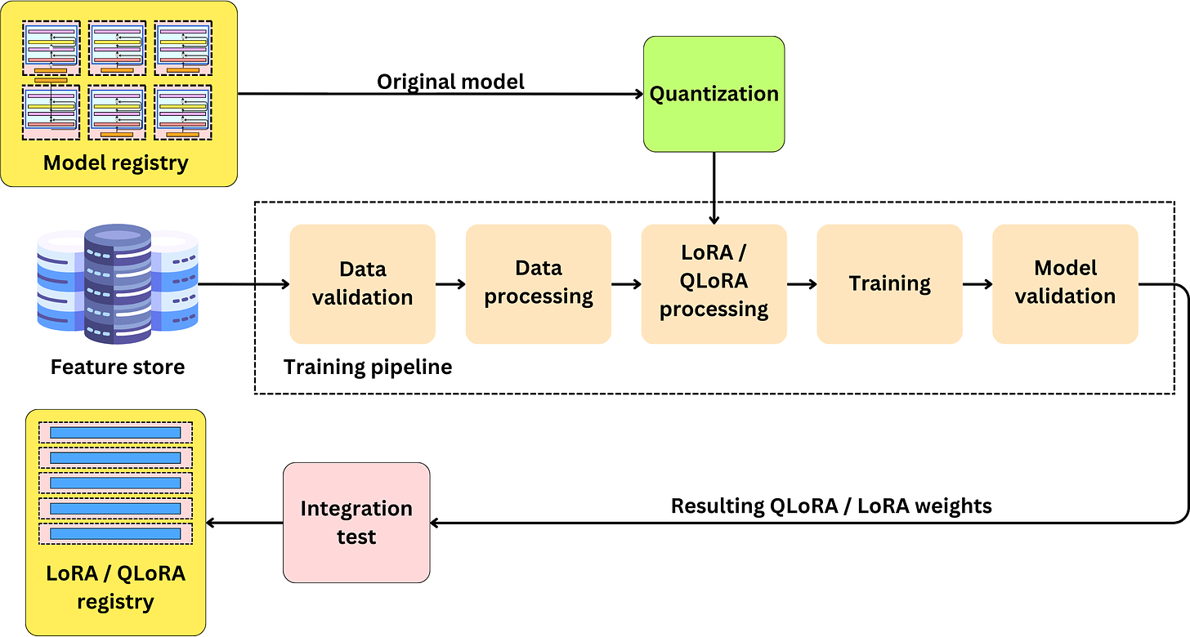
Research Methodology (6/11)
Conference | 24-25 October 2024
Figure 4.1 Training Flow in LLMs (Source: Benveniste, 2023)

Slide 25
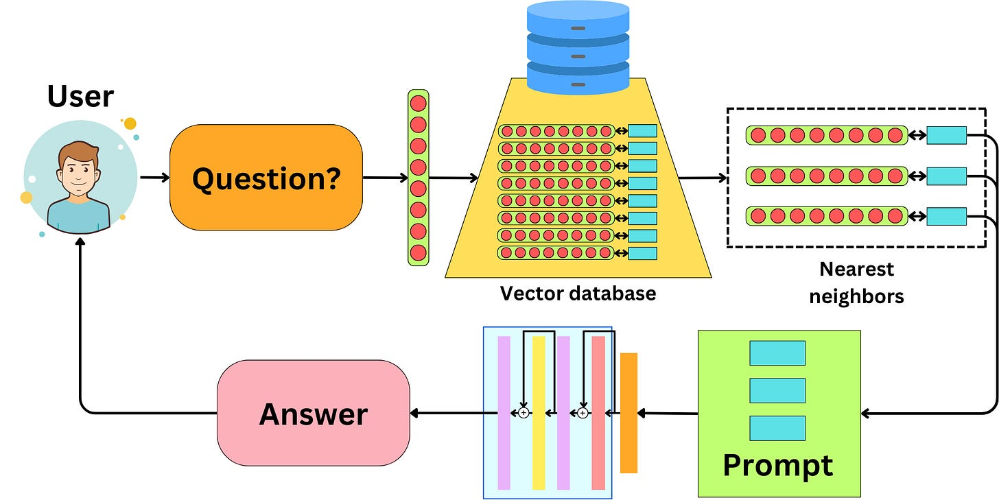
Research Methodology (7/11)
Conference | 24-25 October 2024
Figure 4.2 Grooves on RAG (Source: Benveniste, 2023)
Notes:
The idea of RAG is to encode the data that the LLM wants to expose into embeddings and index that data into a vector database. Cosine similarity is a measure of similarity between two vectors in a deep product space. This measure determines the degree to which two vectors point in the same direction by calculating the cosine of the angle between them. Nearest Neightbor uses Cosine Similarity which measures the similarity between two texts based on the angle between the words vectors. The resulting cosine similarity value ranges from -1 to 1, where -1 indicates a completely dissimilar document (meaning), and 1 indicates an identical document (exactly the same). A value of 0 indicates that the two documents are orthogonal and have nothing in common (not related to each other).

Slide 26
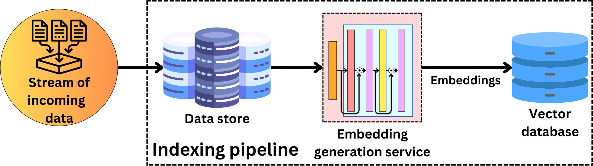
Research Methodology (8/11)
Conference | 24-25 October 2024
Figure 4.3 Discharge Pipeline on RAG (Source:Benveniste, 2023)
Notes:
RAG does not have a training path, only requires an indexing pipeline and a serving pipeline. Indexing pipes are used to convert data into vector representations and index them in the Vector database as can be seen in Figure 4.3 (Benveniste, 2023)

Slide 27
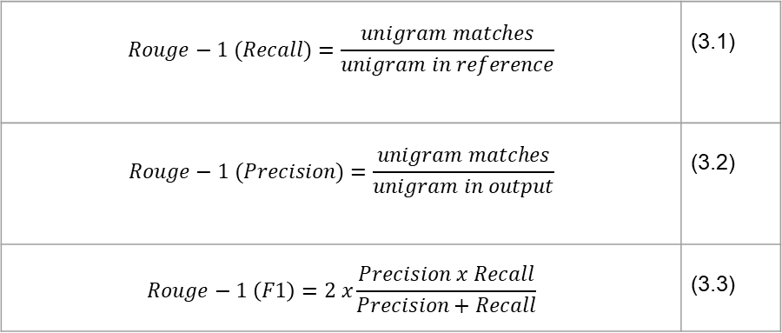
Research Methodology (9/11)
Conference | 24-25 October 2024
Rouge-1
$$Rouge−1 (Recall)=\frac{unigram matches}{unigram in reference}$$ | (3.1)
$$Rouge−1 (Precision)=\frac{unigram matches}{unigram in output}$$ | (3.2)
$$Rouge−1 \left(F1\right)=2 x\frac{Precision x Recall}{Precision+Recall}$$ | (3.3)
Notes:
Rouge-1 measures the accuracy of unigrams (single words) that overlap between the generated text and the reference text (man-made).

Slide 28
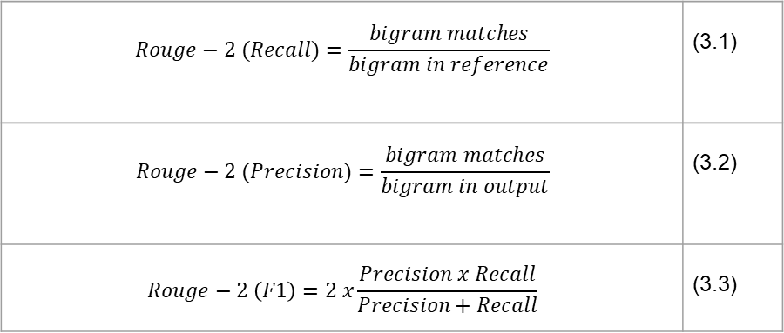
Research Methodology (10/11)
Conference | 24-25 October 2024
Rouge-2
$$Rouge−2 (Recall)=\frac{bigram matches}{bigram in reference}$$ | (3.1)
$$Rouge−2 (Precision)=\frac{bigram matches}{bigram in output}$$ | (3.2)
$$Rouge−2 \left(F1\right)=2 x\frac{Precision x Recall}{Precision+Recall}$$ | (3.3)
Notes:
Rouge-2 measures the accuracy of overlapping bigrams between the generated text and the reference text (man-made). The rouge-2 formula is the same as rouge-1, but the pair of words used are bigrams, not unigrams. Bigram compensates for the Rouge-1 word position problem to some extent

Slide 29
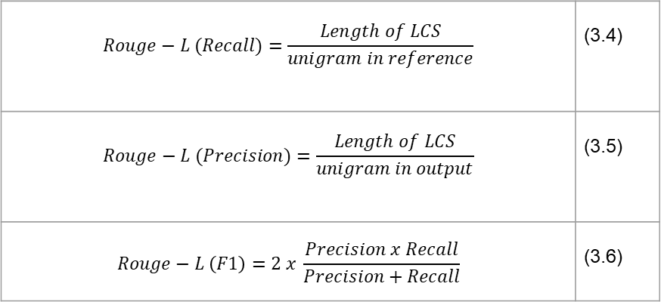
Research Methodology (11/11)
Conference | 24-25 October 2024
Rouge-L
$$Rouge−L (Recall)=\frac{Length of LCS}{unigram in reference}$$ | (3.4)
$$Rouge−L (Precision)=\frac{Length of LCS}{unigram in output}$$ | (3.5)
$$Rouge−L \left(F1\right)=2 x \frac{Precision x Recall}{Precision+Recall}$$ | (3.6)
Notes:
Unlike rouge-1, and rouge-2, Rouge-L does not look into unigrams or bigrams, but rather conforms to LCS (Longest Common Subsequence) or the longest word sequence in the resulting reference and text.

Slide 30
05
Results and Discussion
Conference | 24-25 October 2024

Slide 31
Results and Discussion (1/9)
Conference | 24-25 October 2024
Results with the Fine-tuning method
Question
How to make a Certificate of Active Study?
Reference
Regarding the issue of the Certificate of Active Study, please take care of it to the academic registration section
Answer
Regarding the issue of the Certificate of Active Study, please take care of it to the academic registration section
Score ROUGE
Rouge 1 : 1.0, Rouge 2 : 1.0, Rouge L : 1.0

Slide 32
Results and Discussion (2/9)
Conference | 24-25 October 2024
Answer results with Paraphrase on questions
Basic Questions
How to make a Certificate of Active Study?
Paraphrase Questions
What are the steps to make a Certificate of Active Study?
Reference
Regarding the issue of the Certificate of Active Study, please take care of it to the Academic Registration section.
Answer
To make a Certificate of Active Study, please take care of it to the Academic Registration section.

Slide 33
Results and Discussion (3/9)
Conference | 24-25 October 2024
Results with the RAG method
Question
How to Manage a Certificate of Active Study?
Reference
Handling of the Certificate of Active Lectures, please go to the registration section.
Answer
Please go to the registration section.
Score ROUGE
Rouge 1 : 0.6153, Rouge 2 : 0.5454, Rouge L : 0.6153

Slide 34
Results and Discussion (4/9)
Conference | 24-25 October 2024
Results of Testing and Evaluation of Inference Results
Table 5.1 ROUGE score value
Method | Number of Questions | Score ROUGE
 |  | R-1 | R-2 | R-L
Fine-tuning | 20/20 | 1.0 | 1.0 | 1.0
RAG | 15/56 | >0.5 | >0.5 | >0.5

Slide 35
Results and Discussion (5/9)
Conference | 24-25 October 2024
ROUGE score categories
Table 5.2 ROUGE Metric Value Category Table (Walker II, 2024)
Metrik ROUGE | Excellent | Good | Moderate
ROUGE-1 | 0.5+ | >0.5 | 0.4-0.5
ROUGE-2 | - | >0.4 | 0.2-0.4
ROUGE-L | - | ~0.4 | 0.3-0.4
Notes:
A good ROUGE score varies based on summary tasks and metrics. The ROUGE-1 score is excellent at around 0.5, with a score above 0.5 considered good and 0.4 to 0.5 moderate. For ROUGE-2, a score above 0.4 means good, and 0.2 to 0.4 means moderate. The ROUGE-L score is good at around 0.4 and low at 0.3 to 0.4. While the ROUGE score is useful, it does not take into account semantic or syntactic qualities and should be supplemented with other metrics and human evaluation for a complete assessment.

Slide 36
Results and Discussion (6/9)
Conference | 24-25 October 2024
Calculating Resource Evaluation
Table 5.3 Time Counts on Models When Fine-tuning and Running RAG
Model | Fine-tuning time (hours) | RAG Time (minutes)
USK Mistral 7B | 2 | 5-6

Slide 37
Results and Discussion (7/9)
Conference | 24-25 October 2024
Result Analysis
Training Data Problems
The factors that affect hallucinations in LLMs are the nature of the training data.
Reduces Hallucinations
The main method of identifying and mitigating these errors involves a combination of sophisticated metrics and critical human evaluations such as:
Linguistic quality metrics such as ROUGE and BLEU,
Content validity metrics, namely IE-based, QA-based, and NLI-based (Minaee et al., 2024) and
FactScore to check the accuracy of individual facts.
Notes:
Training Data Problems : LLMs trained on datasets sourced from the internet can contain biased or incorrect information. This misinformation can spread to the model's output, as the model cannot distinguish between accurate and inaccurate data
IE-Based Metrics : Leverages Information Extraction models to simplify knowledge into relational tuples, then compares it to the source.
QA-Based Metrics : Assess the overlap between generated and sourced content through a Q&A framework
NLI-Based Metrics : Use the Natural Language Reference dataset to evaluate the correctness of the hypothesis generated based on the given premise.

Slide 38
Results and Discussion (8/9)
Conference | 24-25 October 2024
Result Analysis
Method of Retrieval-Augmented Generation (RAG)
Innovative methods such as SelfCheckGPT detect hallucinations by assessing the consistency of multiple answers generated to the same question. In addition, techniques such as chain-of-thought prompting and Retrieval-Augmented Generation (RAG) are constantly being explored to strengthen the model's ability to provide precise and relevant information.
Notes:
Chain-of-thought prompting (CoT) is a technique that helps large language models (LLMs) to think step by step, like humans. Chain of Thought (CoT) instruction is a technique that guides LLMs to follow the reasoning process when faced with difficult problems.

Slide 39
Results and Discussion (9/9)
Conference | 24-25 October 2024
Result Analysis
The Influence of GPUs in LLM Implementation
In running LLMs, GPUs play an important role. Dedicated GPUs with high VRAM can significantly accelerate the computation required by the model. In this study, the GPU used is the "NVIDIA Tesla T4 GPU" which is available on Google Colab for free, the results of testing with this GPU using the RAG method take 4-5 minutes to be able to generate responses to the questions asked.

Slide 40
06
Conclusion and Suggestion
Conference | 24-25 October 2024

Slide 41
Conclusion (1/3)
Conference | 24-25 October 2024
The chatbot to obtain academic information has been successfully built with an accuracy of ROUGE score of >0.5. In ROUGE 1, ROUGE 2, and ROUGE L. The ROUGE score was obtained from testing using 56 academic-related questions at USK, a total of 15 questions got a good score, namely with a score of >0.5.
The performance comparison between fine-tuning and RAG shows that the scores of ROUGE 1, ROUGE 2, and ROUGE L in fine-tuning get a good score of >0.5. This score is obtained by testing on the model by giving different questions but have the same meaning. Performance using the RAG method resulted in scores on ROUGE 1, ROUGE 2, and ROUGE L with a value of >0.5 tested on 15 out of 56 questions asked.

Slide 42
Conclusion (2/3)
Conference | 24-25 October 2024
Next...
The academic information file in the form of a statement was successfully built with a total of 231 statements of academic information data at USK. This document is used in chatbots using the RAG method. The results give the model an increase in time to generate responses related to topics in the academic field and improve the accuracy of the model.

Slide 43
Suggestion (3/3)
Conference | 24-25 October 2024
It is recommended for further research in addition to adding datasets so that the model becomes more reliable. Tests can be carried out on other newer models with more advanced features. By exploring this, you can find comparisons on other models so that you can get the best model for the domain of academic administration services

Slide 44
Thank you
Notes:
So, This is the end of my presentation,
Thank you for your time and attention
If you have any question, please feel free to ask.

